Slide 1
Modal Verbs of Necessity ☺
Basic 12

Slide 2
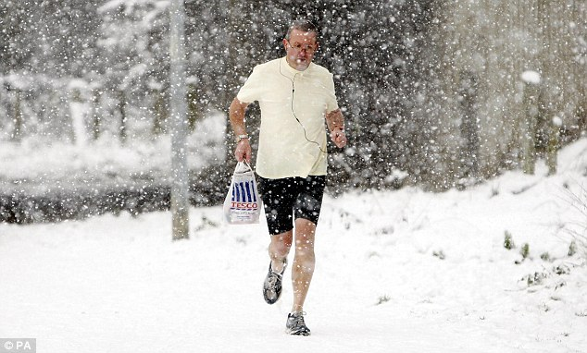

Slide 3
MODAL AUXILIARIES
AUXILIARY + SIMPLE FORM OF VERB
should (e) He should wear more clothes.
had better (f) He had better put on a jacket.

Slide 4
MODAL AUXILIARIES
AUXILIARY + SIMPLE FORM OF VERB
could
must
should
can
had better
may
not followed by to
Inga can to play the violin.

Slide 5
MODAL AUXILIARIES
AUXILIARY + SIMPLE FORM OF VERB
could
must
should
can
had better
may
no final -s
Inga can plays the violin.

Slide 6
MODAL AUXILIARIES
AUXILIARY + SIMPLE FORM OF VERB
could
must
should
can
had better
may
not in past form
Inga can played the violin.

Slide 7
MODAL AUXILIARIES
AUXILIARY + SIMPLE FORM OF VERB
could
must
should
can
had better
may
not in -ing form
Inga can playing the violin.

Slide 8
MODAL AUXILIARIES
AUXILIARY + TO + SIMPLE FORM OF VERB
have to (j) You have to eat something.
have got to (k) He has got to be on time.
to + simple form

Slide 9
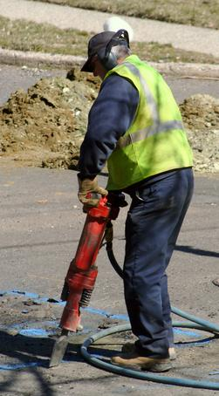
EXPRESSING NECESSITY: HAVE TO, HAVE GOT TO, MUST
This man has to wear ear protection.

Slide 10
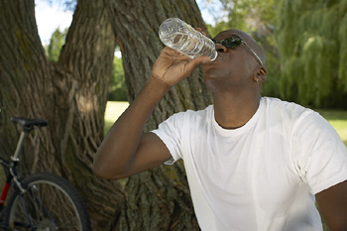
EXPRESSING NECESSITY: HAVE TO, HAVE GOT TO, MUST
People need to drink water.
People have to drink water.

Slide 11
13-2 USING HAVE + INFINITIVE (HAVE TO/HAS TO)
(a) People need to drink water.
same
meaning
(b) People have to drink water.
(c) Lance needs to work.
same
meaning
(d) Lance has to work.
have + infinitive = need

Slide 12
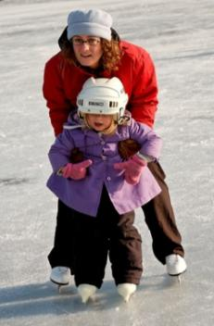
LET’S PRACTICE
to
Ø
to
She has ___ learn how to skate.

Slide 13
LET’S PRACTICE
to
Ø
Ø
She must ___ learn how to skate.

Slide 14
LET’S PRACTICE
to
Ø
to
She has ___ learn how to skate.

Slide 15
13-2 USING HAVE + INFINITIVE (HAVE TO/HAS TO)
(f) Does she have to work tonight?
(g) What time do you have to work?
(h) Why did you have to work today?
QUESTION FORM:
do, does, did used with have to

Slide 16
13-2 USING HAVE + INFINITIVE (HAVE TO/HAS TO)
(i) I don’t have to work today.
He doesn’t have to go home.
(j) The bus was early.
We didn’t have to wait.
NEGATIVE FORM:
don’t, doesn’t, didn’t
used with have to

Slide 17
EXPRESSING NECESSITY: HAVE TO, HAVE GOT TO, MUST
(a) I want to become a doctor.
I go to medical school.
have to
have got to
must
have to
have got to
had better
same
meaning
something is necessary

Slide 18
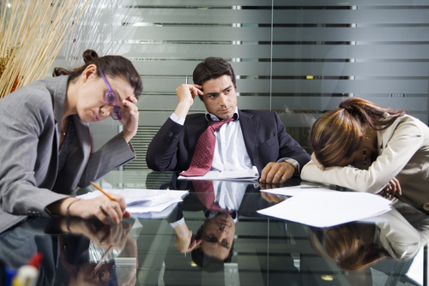
EXPRESSING NECESSITY: HAVE TO, HAVE GOT TO, MUST
(c) It’s late. We’ve got to go home.

Slide 19
EXPRESSING NECESSITY: HAVE TO, HAVE GOT TO, MUST
(b) I have to go to soccer practice.
(c) We’ve got to go home.
(d) Everyone must wear a seatbelt
on an airplane.
have to
have got to
must
common
informal conversation
written instructions

Slide 20
EXPRESSING NECESSITY: HAVE TO, HAVE GOT TO, MUST
Do you have to wear seatbelts in your car?
Did they all have to come?
have to
have got to
must
Questions

Slide 21
EXPRESSING NECESSITY: HAVE TO, HAVE GOT TO, MUST
(e) Do you have to wear seatbelts in your car?
(f) Did they all have to come?
have to
have got to
must
Questions

Slide 22
EXPRESSING NECESSITY: HAVE TO, HAVE GOT TO, MUST
(e) Do you have to wear seatbelts in your car?
(f) Did they all have to come?
have to
have got to
must
Questions

Slide 23
EXPRESSING NECESSITY: HAVE TO, HAVE GOT TO, MUST
(g) We had to clean up the mess.
Past form:
have to
have got to
must
had to

Slide 24
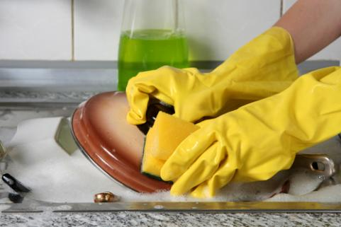
CORRECT
?
YES
NO
Do I must wash all the dishes?

Slide 25
CORRECT
?
YES
NO
Do I have to wash all the dishes?

Slide 26
CORRECT
?
YES
NO
Do I have got to wash all the dishes?

Slide 27

EXPRESSING LACK OF NECESSITY: DO NOT HAVE TO EXPRESSING PROHIBITION: MUST NOT
(b) Alesha is on vacation.
She doesn’t have to go to work today.
not necessary

Slide 28

(e) You don’t have to come
to my party if you don’t
have time.
don’t have to = you have a choice

Slide 29

We cleaned the house this morning.
We _________________________ now.
don’t have to clean the house

Slide 30
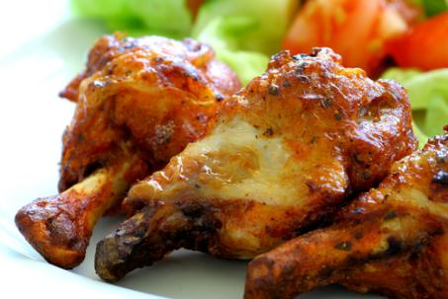
I cooked dinner this morning.
I ______________________ tonight.
don’t have to cook dinner

